Slide 1
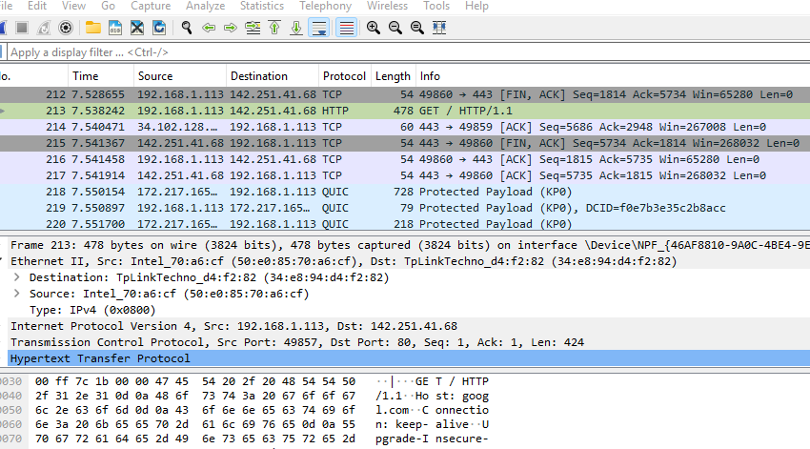

What is Wireshark
Wireshark is a software protocol analyzer, also known as a “packet sniffer,” used for network troubleshooting, analysis, software and protocol development, and education. A packet sniffer, also known as a network analyzer or protocol analyzer, is computer software that intercepts and logs data traffic passing over a data network. As data streams travel back and forth over the network, the sniffer "captures" each protocol data unit (PDU) and can decode and analyze its content according to the appropriate RFC or other specifications.

Slide 2
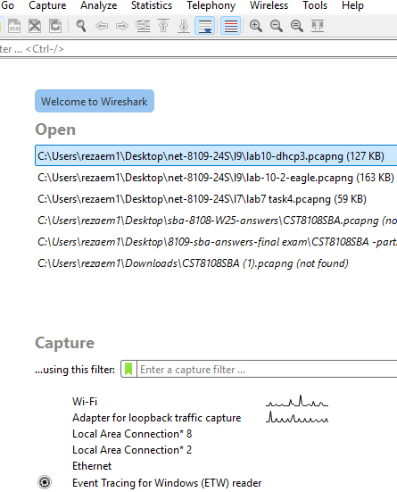
Disable extra network adapters
Disabled
Enabled
w

Slide 3
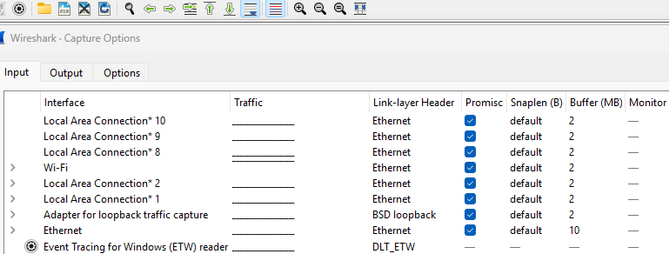
WS Option
WS

Slide 4
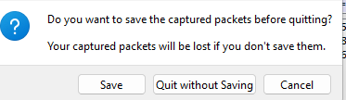
To capture packets
Make sure all network adapters such as Wi-Fi, VMware are disabled except the Ethernet adapter.
To capture packets, choose your Ethernet adapter and then click on the start to capture icon. WS begins to capture the traffic.
To stop the WS, click on the square icon.
To save, click on the X (top right).

Slide 5
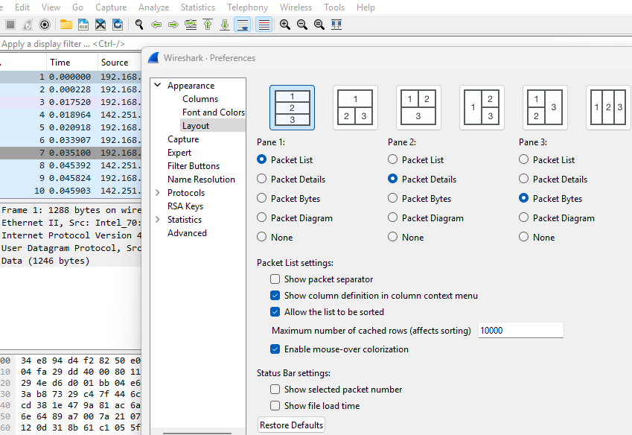
To change layout
Click on Edit, preference, and then layout

Slide 6
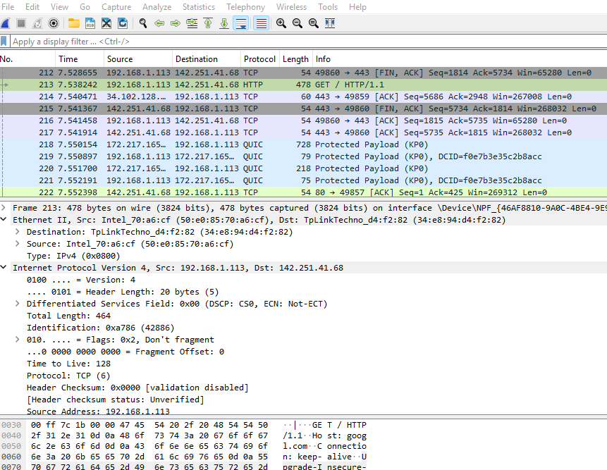
WS parts
parts
Tools
Packet List Pane
Details Pane
Data

Slide 7
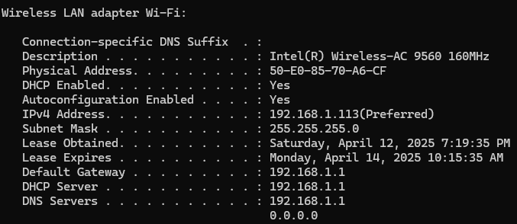
My IP and MAC addresses
To find my IP and MAC address in CMD, type C:\ Ipconfig /all
MAC

Slide 8

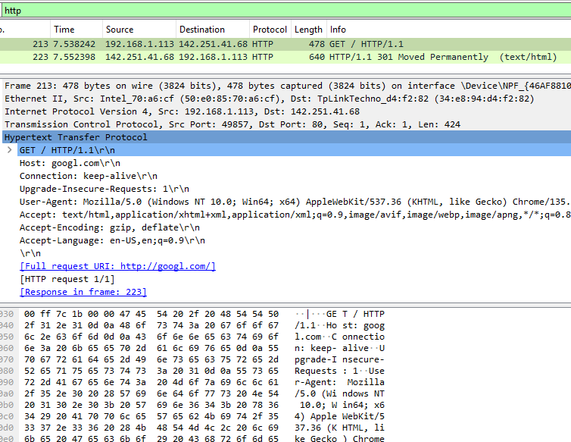
Capture HTTP protocol
Filter
1- Run WS
2- Go to your browser and type google.com
3- Wait for 5 seconds or more
4- Stop the WS
5- Filter with http

Slide 9
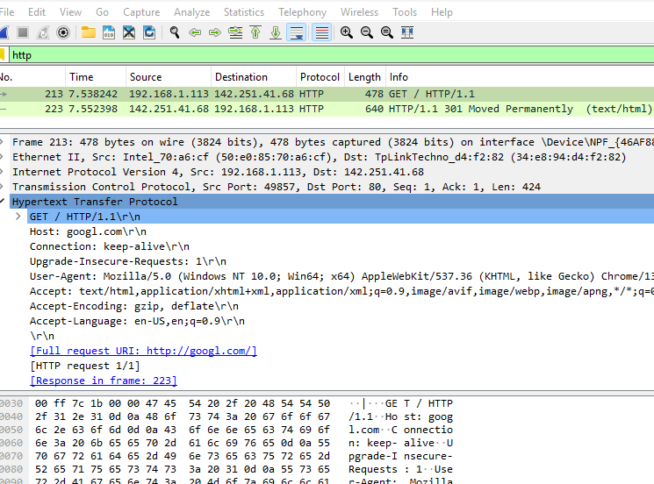
WS parts
d

Slide 10
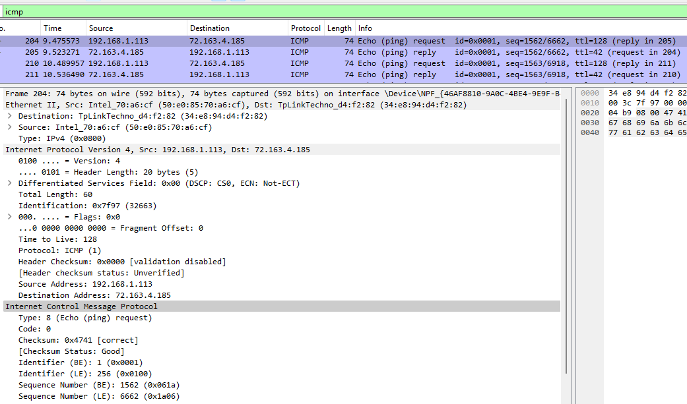
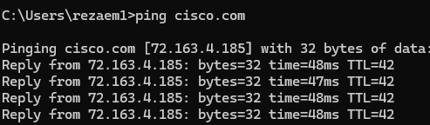
Icmp protocol
icmp
My MAC

Slide 11
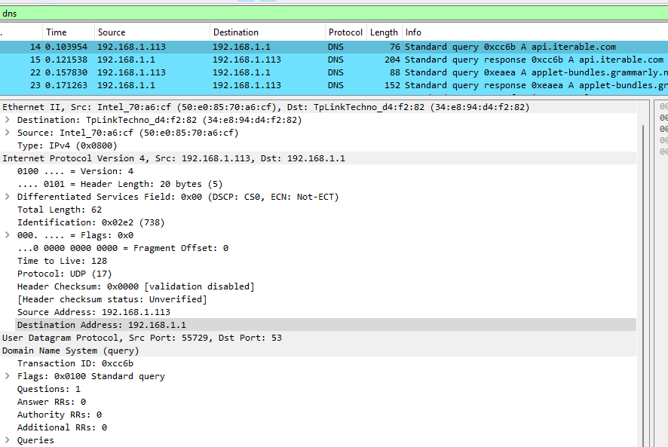
Domain Name System (DNS)
dn

Slide 12
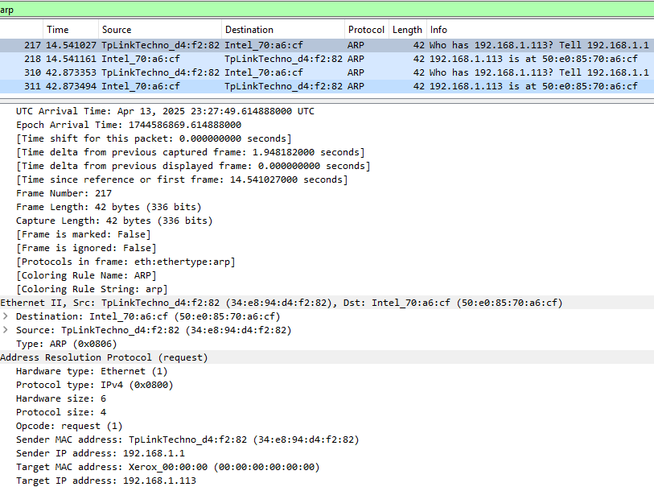
Address Resolution Protocol (ARP)
arp

Slide 13
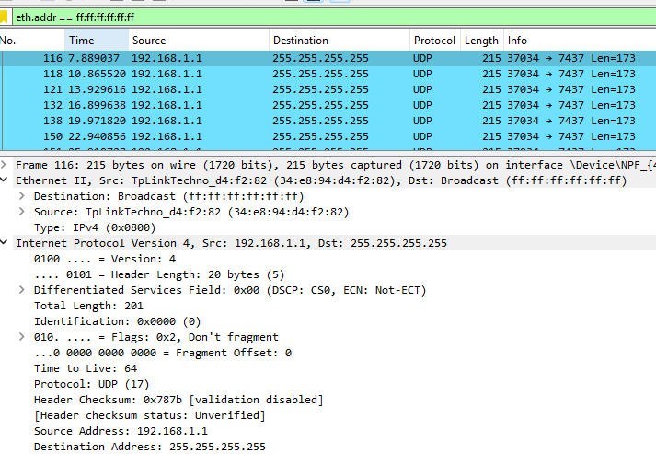
Broadcast signal
b

